Slide 1

#LifeKoKaroLift
Data Science Certification Program

Slide 2


Course : Data Science
Lecture On : Data Visualization
Instructor : Shivani Kapania

Slide 3
In Last Class, we covered….
Cleaning data – handling missing values
Questions!!

Slide 4
Today’s Agenda
Introduction to visualization
Types of charts

Slide 5
What is data visualization?
To convey information through a visual representation.
To communicate insights from data.
To expose patterns, trends, correlations that might not be otherwise detected.
Data visualization = storytelling with a purpose.
Visual = relating to sight/ seeing

Slide 6
Why do we use it?
Answer questions (or discover them)
Make decisions
See data in context
Find patterns
Present argument/ tell a story
Inspire!
Visualization
Record
Analyze
Communicate

Slide 7
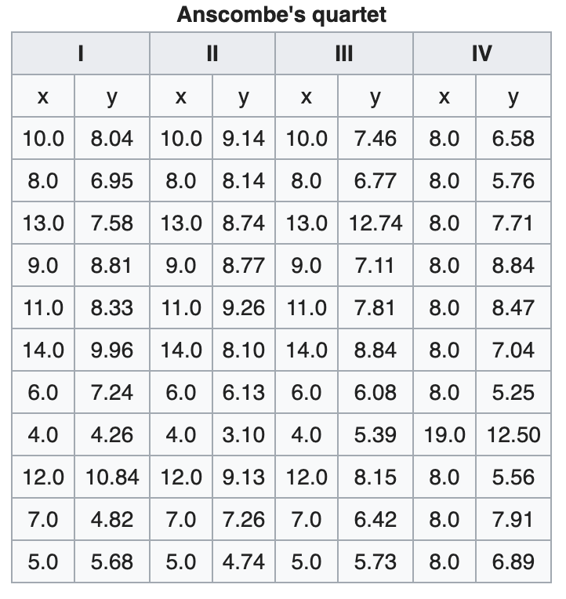
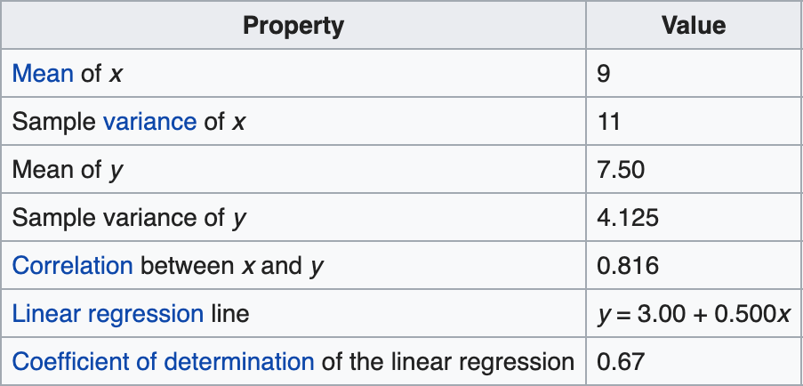
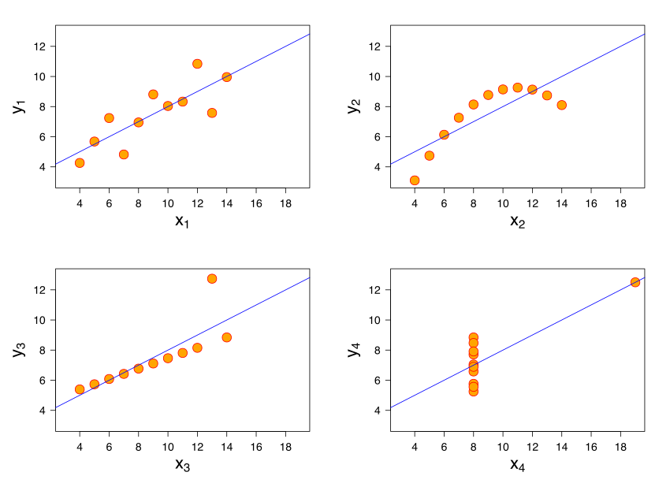
Anscombe’s quartet

Slide 8
Anscombe’s quartet
Constructed in 1973 by the statistician Francis Anscombe.
Four datasets:
Have nearly identical simple descriptive statistics.
Each dataset consists of eleven (x,y) points.
Demonstrates:
Importance of graphing data before analyzing it
Effect of outliers and other influential observations on statistical properties

Slide 9
Types of charts
Charts
Bar chart
Line chart
Scatter chart
Pie chart
Histogram
Chart = graphical representation of data

Slide 10
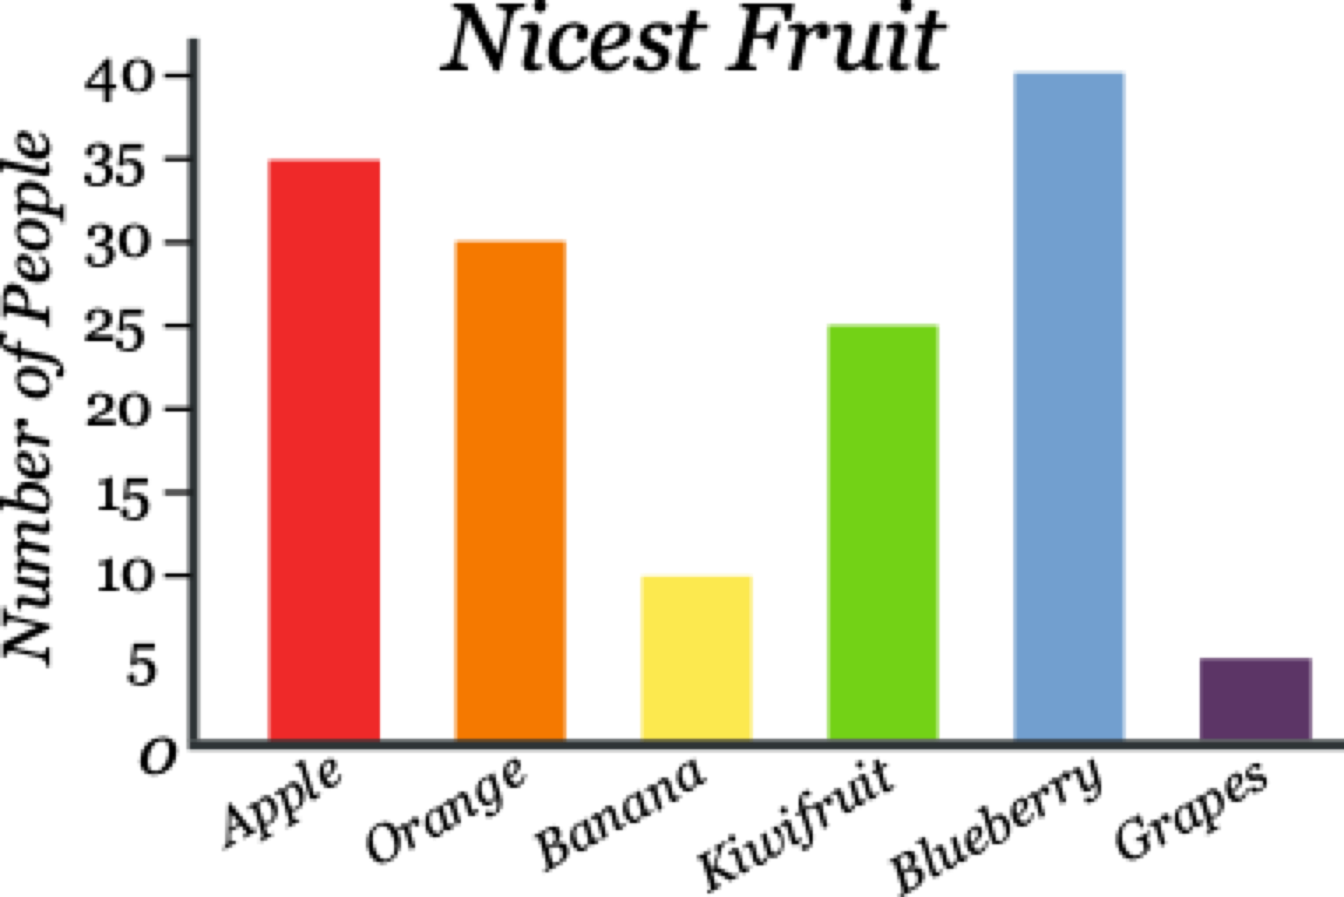
Bar chart
Presents categorical data with rectangular bars
Heights or lengths proportional to the values that they represent.
May be vertical or horizontal.
USAGE:
To compare things between different groups
To track changes over time

Slide 11
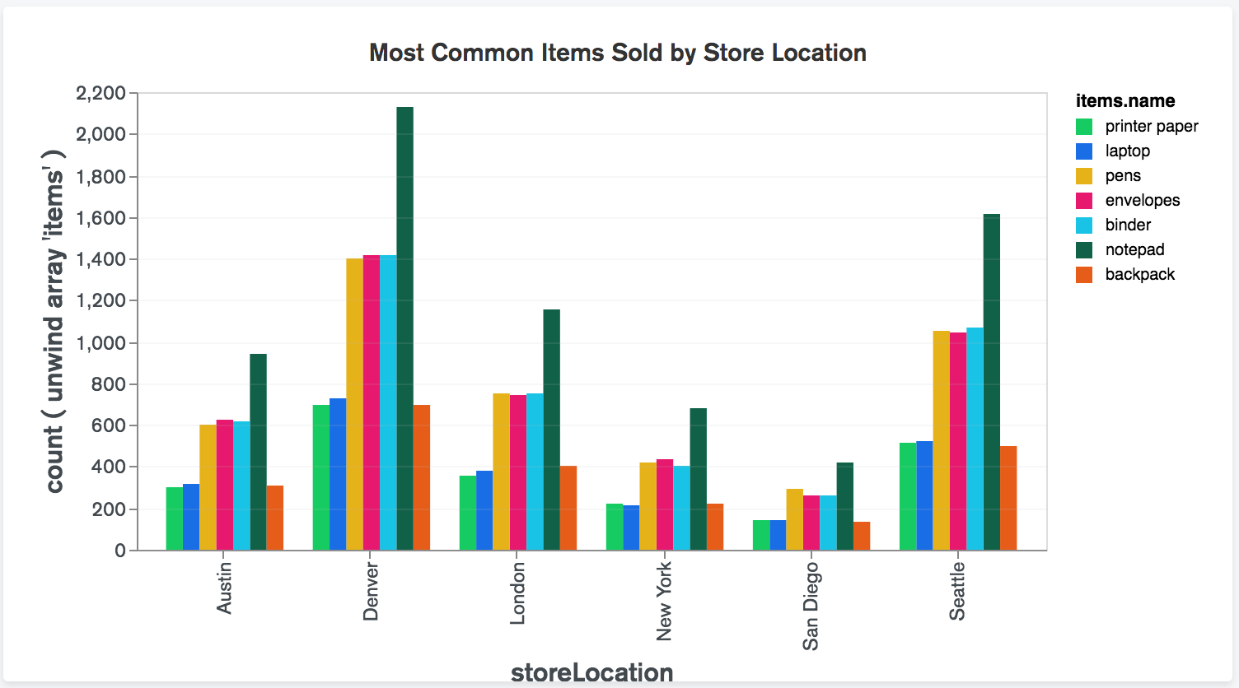
Bar chart

Slide 12
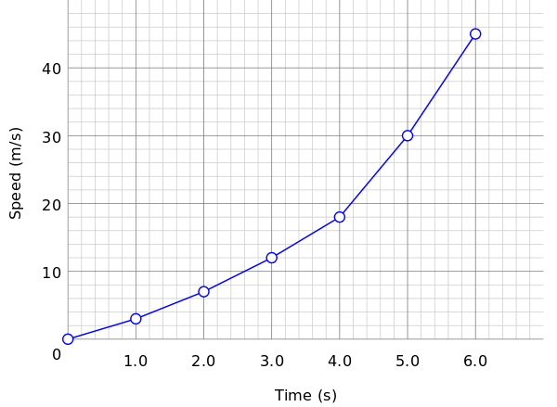
Line graph
Displays information as a series of data points called 'markers' connected by straight line segments.
USAGE:
To show resulting data relative to a continuous variable
To understand trends, fluctuations, patterns
To compare different yet related data sets with multiple series
To track changes over short and long periods of time.

Slide 13
Line graph

Slide 14
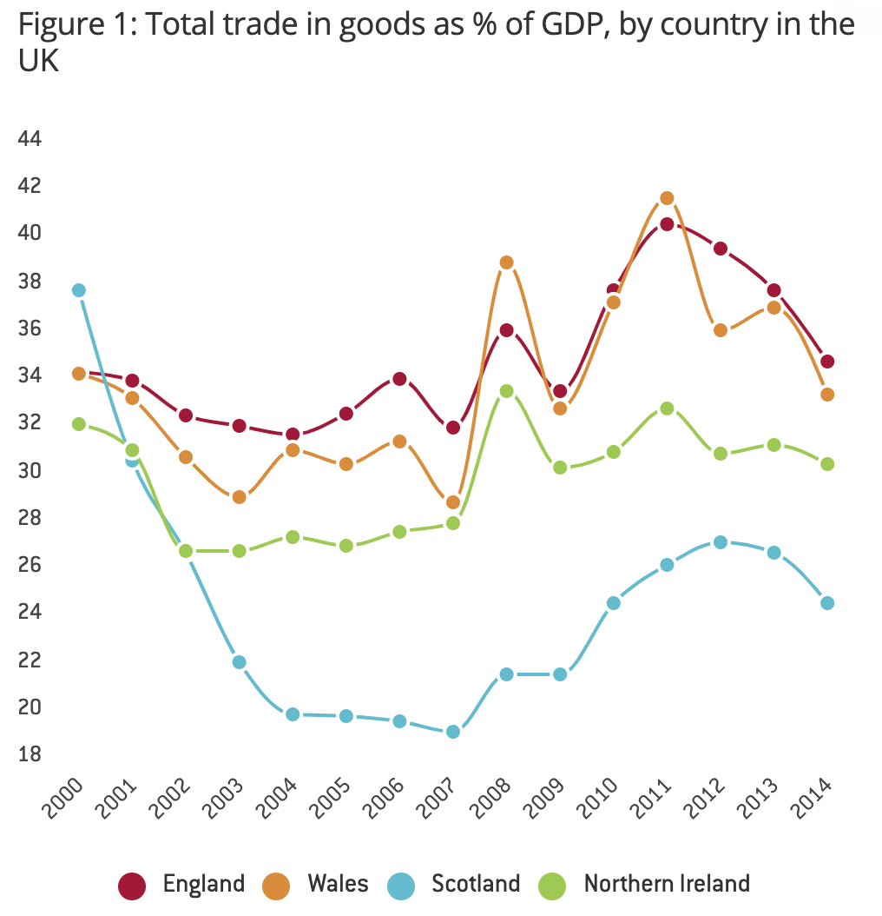
Line graph

Slide 15
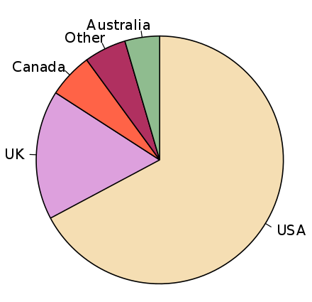
Pie chart
Circular statistical graphic.
Divided into slices to illustrate numerical proportion.
Arc length/Area/central angle is proportional to the quantity it represents.
USAGE:
To compare parts of a whole. They do not show changes over time.
Pie chart of populations of English native speakers

Slide 16
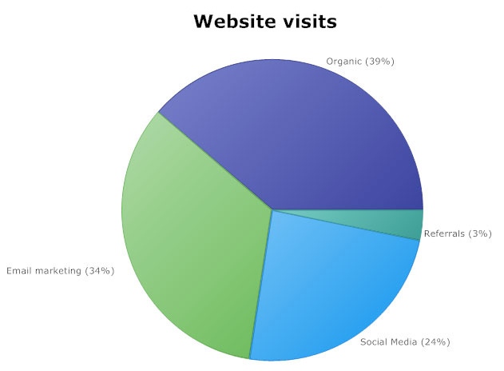
Pie chart

Slide 17
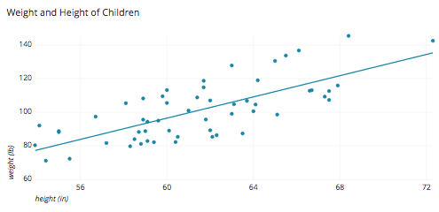
Scatter plot
The data are displayed as a collection of points.
Shows the relationship between two different variables.
If the points are coded (color/shape/size), one additional variable can be displayed.
USAGE:
When you have paired numerical data
When trying to determine whether the two variables are correlated

Slide 18
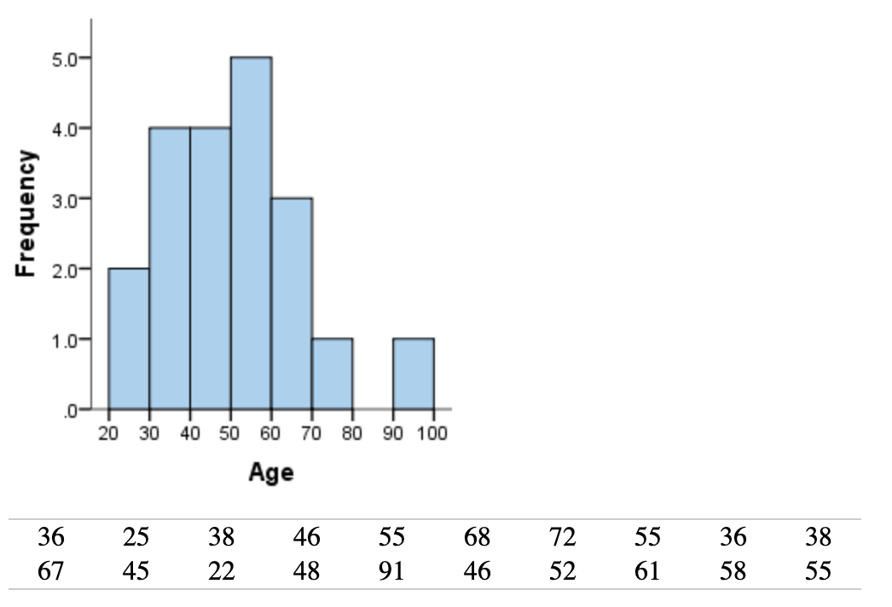
Histogram
A histogram is an accurate representation of the distribution of numerical data.
Bar graph relates two variables, but a histogram relates only one.
Divide the entire range of values into a series of intervals—and then count how many values fall into each interval.

Slide 19
#LifeKoKaroLift
Thank You!

